Slide 1

Steve Bishop Sr. Software Architect Gartman Technical Services
Website: ProgrammingMadeEZ.com
Work: GartmanTechnical.com
Facebook: Facebook.com/ProgrammingMadeEZ
Blog: Tech-Tid-Bits.Blogspot.com
Twitter: @Xipooo
Consultant in IT and Software Development 15+ years
SQL Server DBA
.NET Full Stack Developer
Emphasis on ASP.NET MVC/WebAPI

Slide 2
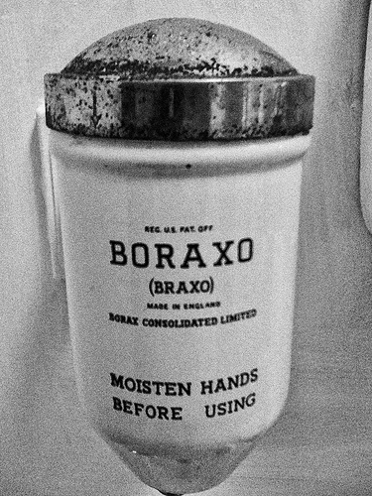
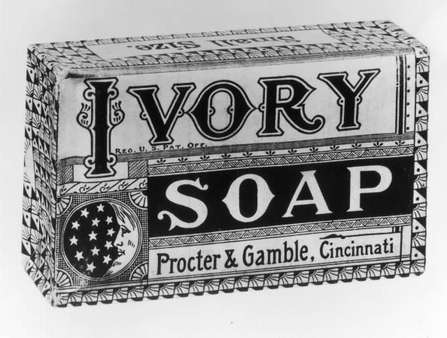
Hand Soap IN the 1920’s
Powdered
Bar

Slide 3
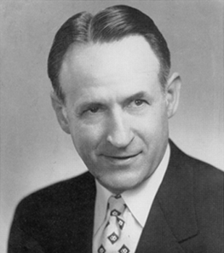
Kutol Products Company
Cleo
Noah
?

Slide 4
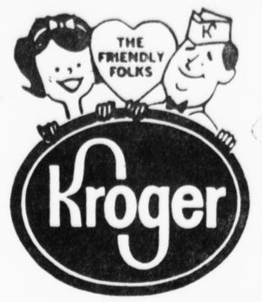
1933 Meeting With Kroger

Slide 5
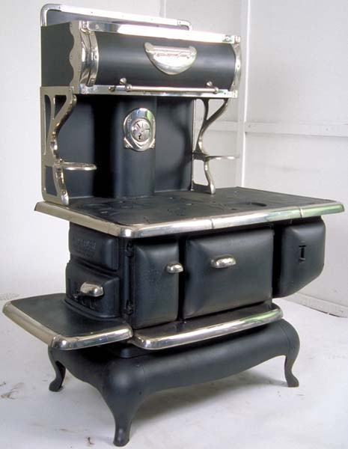
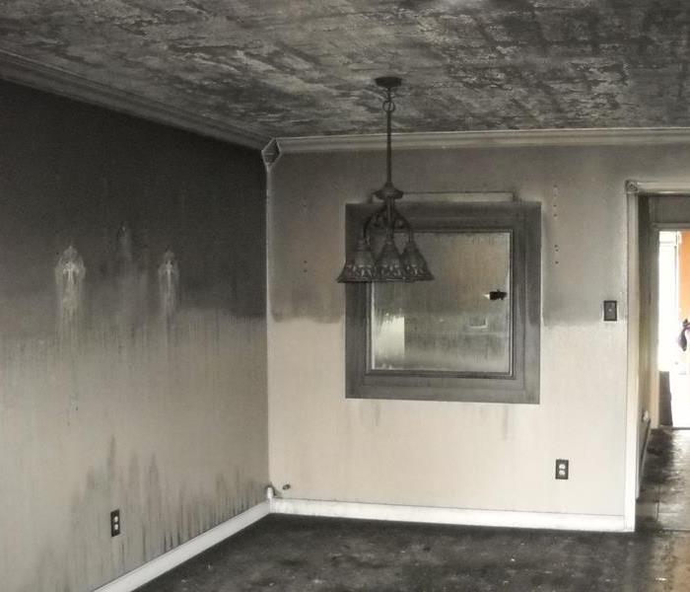
Coal stoves

Slide 6
Can you make a cleaner for walls?
SURE!
Cleo
?
Well we just make soap so I….
Noah

Slide 7
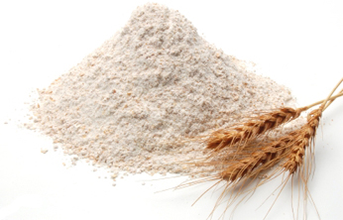

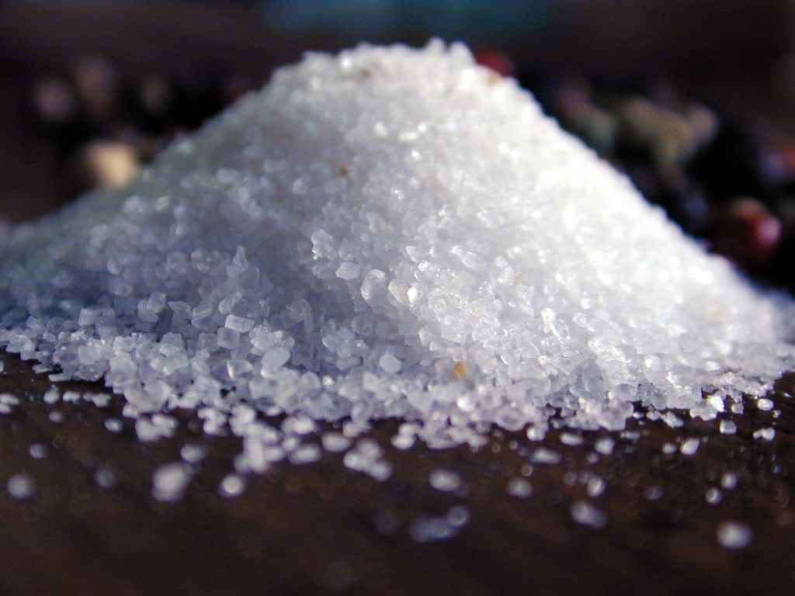
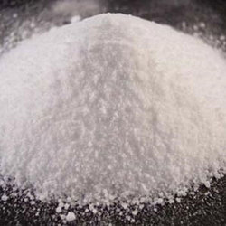

The Mixture
Noah
Flour
Water
Salt
Boric Acid
Mineral Oil

Slide 8
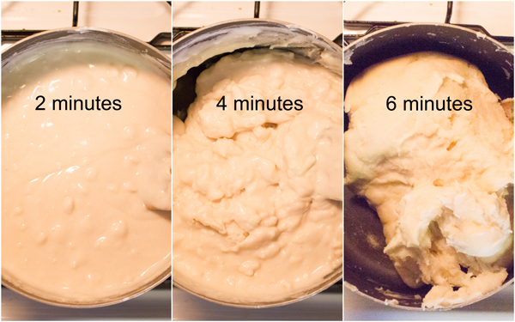
The REsult

Slide 9
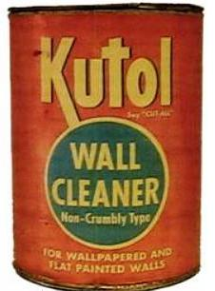
Wall Cleaner

Slide 10
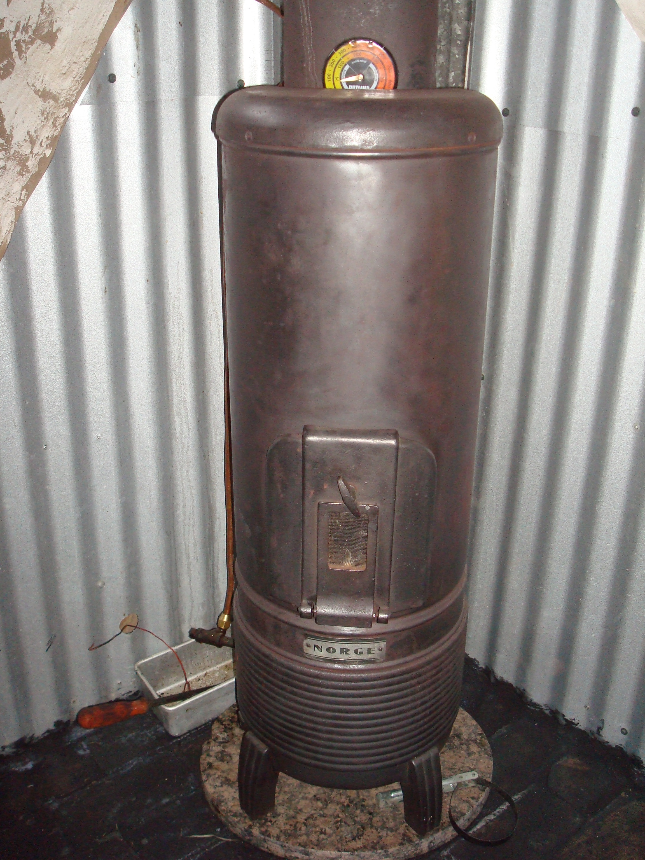
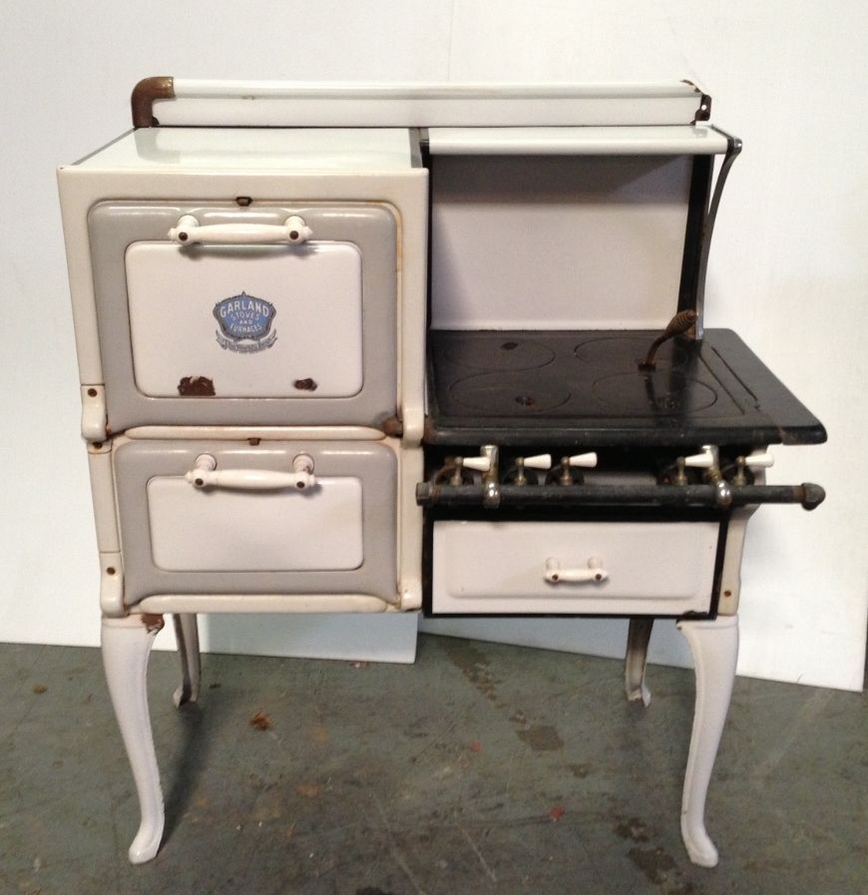
Oil and Gas Overtake Coal

Slide 11
No More Coal Smoke

Slide 12

Sales Slow Down
In 1949
Cleo Dies
CRAP!
Noah

Slide 13
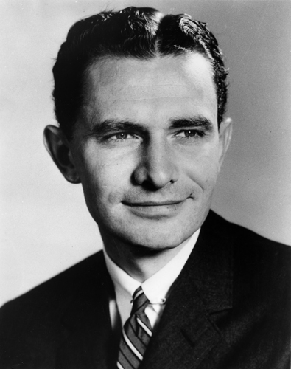
Joe
(The Nephew)
Noah
Damn you’re handsome!
Uhhh, Ok.
Alright!
Come work for me.

Slide 14
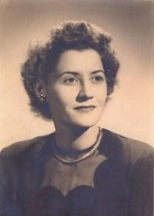

Kay
(Joe’s Sister In-Law)
Joe
(The Nephew)
?

Slide 15
SOLID Principles
Practices for making better code

Slide 16
SOLID Stands For:
Single Responsibility Principle
every module or class should have responsibility over a single part of the functionality provided by the software
Open/Closed Principle
Classes, Modules, and functions should be open for extension but closed for modification.
Liskov Substitution Principle
Sub-classes should be interchangeable with Their base class
Interface segregation principle
No client should be forced to depend on methods it does not use (Make Smaller Interfaces & more of them)
Dependency Inversion Principle
High-Level modules should not depend on low-level modules. BOTH should depend on abstractions.

Slide 17
Result
The Good
Decoupled Code
Easier to maintain
Easier to Extend
Easier To Replace
Easier To Test
The BAD
More Thinking
More Code?
More Time?
More Money?

Slide 18
Non-SOLID Code

Slide 19
SOLID Code

Slide 20
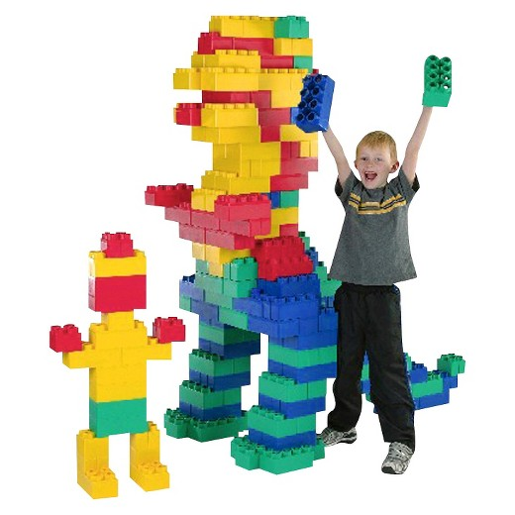
Big Blocks
Dinosaur
???

Slide 21
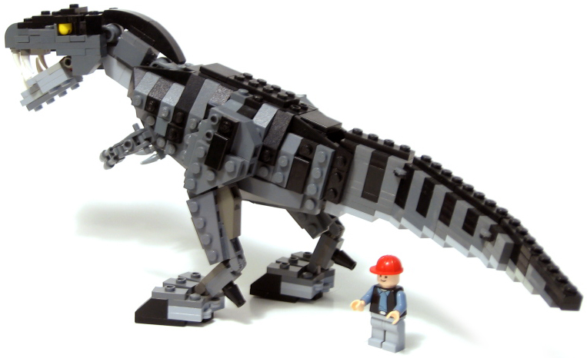
Small Blocks
Dinosaur
Man

Slide 22
Single Responsibility Principle Creates Architecture every module or class should have responsibility over a single part of the functionality
API
Domain Layer
UI
Service Layer
DAL
HomeController
Index
About
Contact
Error
AboutController
About
Orchestrator
GetAboutPage()
AboutView
Description
Repository/Service
Description
ContactController
Contact
Orchestrator
GetContactPage()
ContactView
Contact
Repository/Service
Email
Phone
Address
ErrorController
Error
Orchestrator
GetErrorPage()
LogError()
ErrorView
Error
Repository/Service
ErrorInfo

Slide 23
Open/Closed Principle Classes, Modules, and functions should be open for extension but closed for modification.
public void DoSomething() {
var businessRule = new BusinessRule();
businessRule.Execute();
}
Coupled Code
public void DoSomething(IBusinessRule businessRule) {
businessRule.Execute();
}
Decoupled Code
public void DoSomething(List<IBusinessRule> businessRules) {
foreach (IBusinessRule businessRule In businessRules) {
businessRule.Execute();
}
}
Ultimate Cosmic
Power

Slide 24
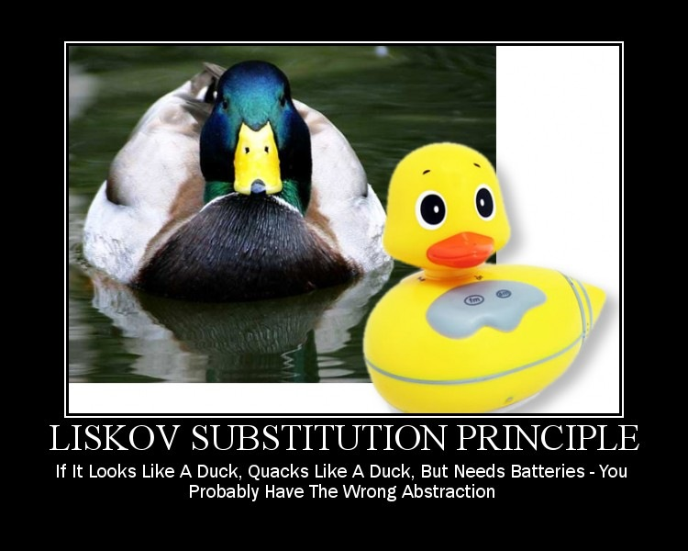
Liskov Substitution Principle Sub-classes should be interchangeable with Their base class
FlyingBirdClass : Bird Class
Eat()
Poop()
Fly()
BirdClass
Eat()
Poop()
BirdClass
Eat()
Poop()
Fly()
PigeonClass : FlyingBirdClass
Eat()
Poop()
Fly()
PenguinClass : BirdClass
Eat()
Poop()
Fly()
PigeonClass : BirdClass
Eat()
Poop()
Fly()

Slide 25
Interface Segregation Principle No client should be forced to depend on methods it does not use
IFly
Fly()
IFlyingBird : IBird, IFly
IBird
Eat()
Poop()
PigeonClass
Eat()
Poop()
Fly()
PigeonClass : IFlyingBird
Eat()
Poop()
Fly()
PenguinClass
Eat()
Poop()
PenguinClass : IBird
Eat()
Poop()

Slide 26
Dependency Inversion Principle High-Level modules should not depend on low-level modules. BOTH should depend on abstractions.
Dependency Resolver/
IOC Container
Orchestrator
Inputs: Abstractions
Outputs: Abstractions
OCP
**No New Objects**
BusinessRule
Inputs: Abstractions
Outputs: Abstractions
OCP
**No New Objects**
BusinessRuleResponse
DBRepository
IRepository
IResponse
Dependency Injection
public IResponse BusinessRule(IRepository repo, IResponse response) {
var model = repo.GetAll();
response.Model = model;
return response;
}

Slide 27
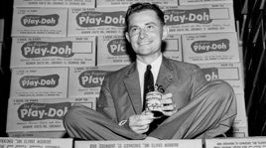
Workshop Time!
Build an application that takes a vehicle Make and vehicle Year from the user,
and based on a set of business rules accepts or rejects the entry.
The rules are as follows:
Users can enter either a 2 or 4 digit year
The make does not need to be case sensitive
We are only accepting Mazda’s 1997 and newer
We are only accepting Toyota’s between 2006 and 1999
Solution: https://github.com/Xipooo/SOLIDPrinciplesDemo
Joe McVicker
Play-Doh

Slide 28
SOLID Stands For:
Single Responsibility Principle
every module or class should have responsibility over a single part of the functionality provided by the software
Open/Closed Principle
Classes, Modules, and functions should be open for extension but closed for modification.
Liskov Substitution Principle
Sub-classes should be interchangeable with Their base class
Interface segregation principle
No client should be forced to depend on methods it does not use (Make Smaller Interfaces & more of them)
Dependency Inversion Principle
High-Level modules should not depend on low-level modules. BOTH should depend on abstractions.

